Slide 1

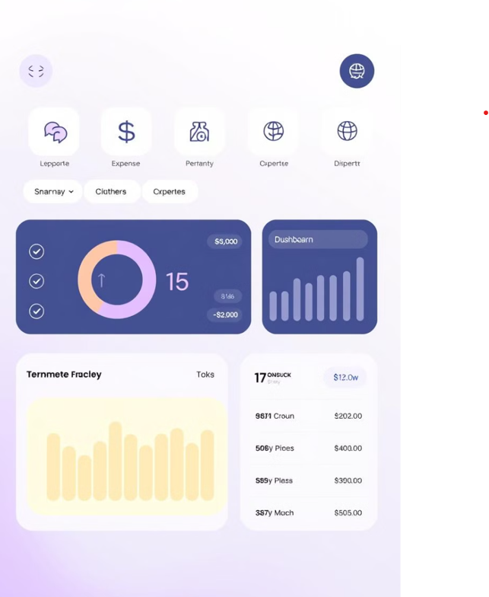

PROJECT
PRESENTATION
Intelligent finance Tracker
Team-2

Slide 2

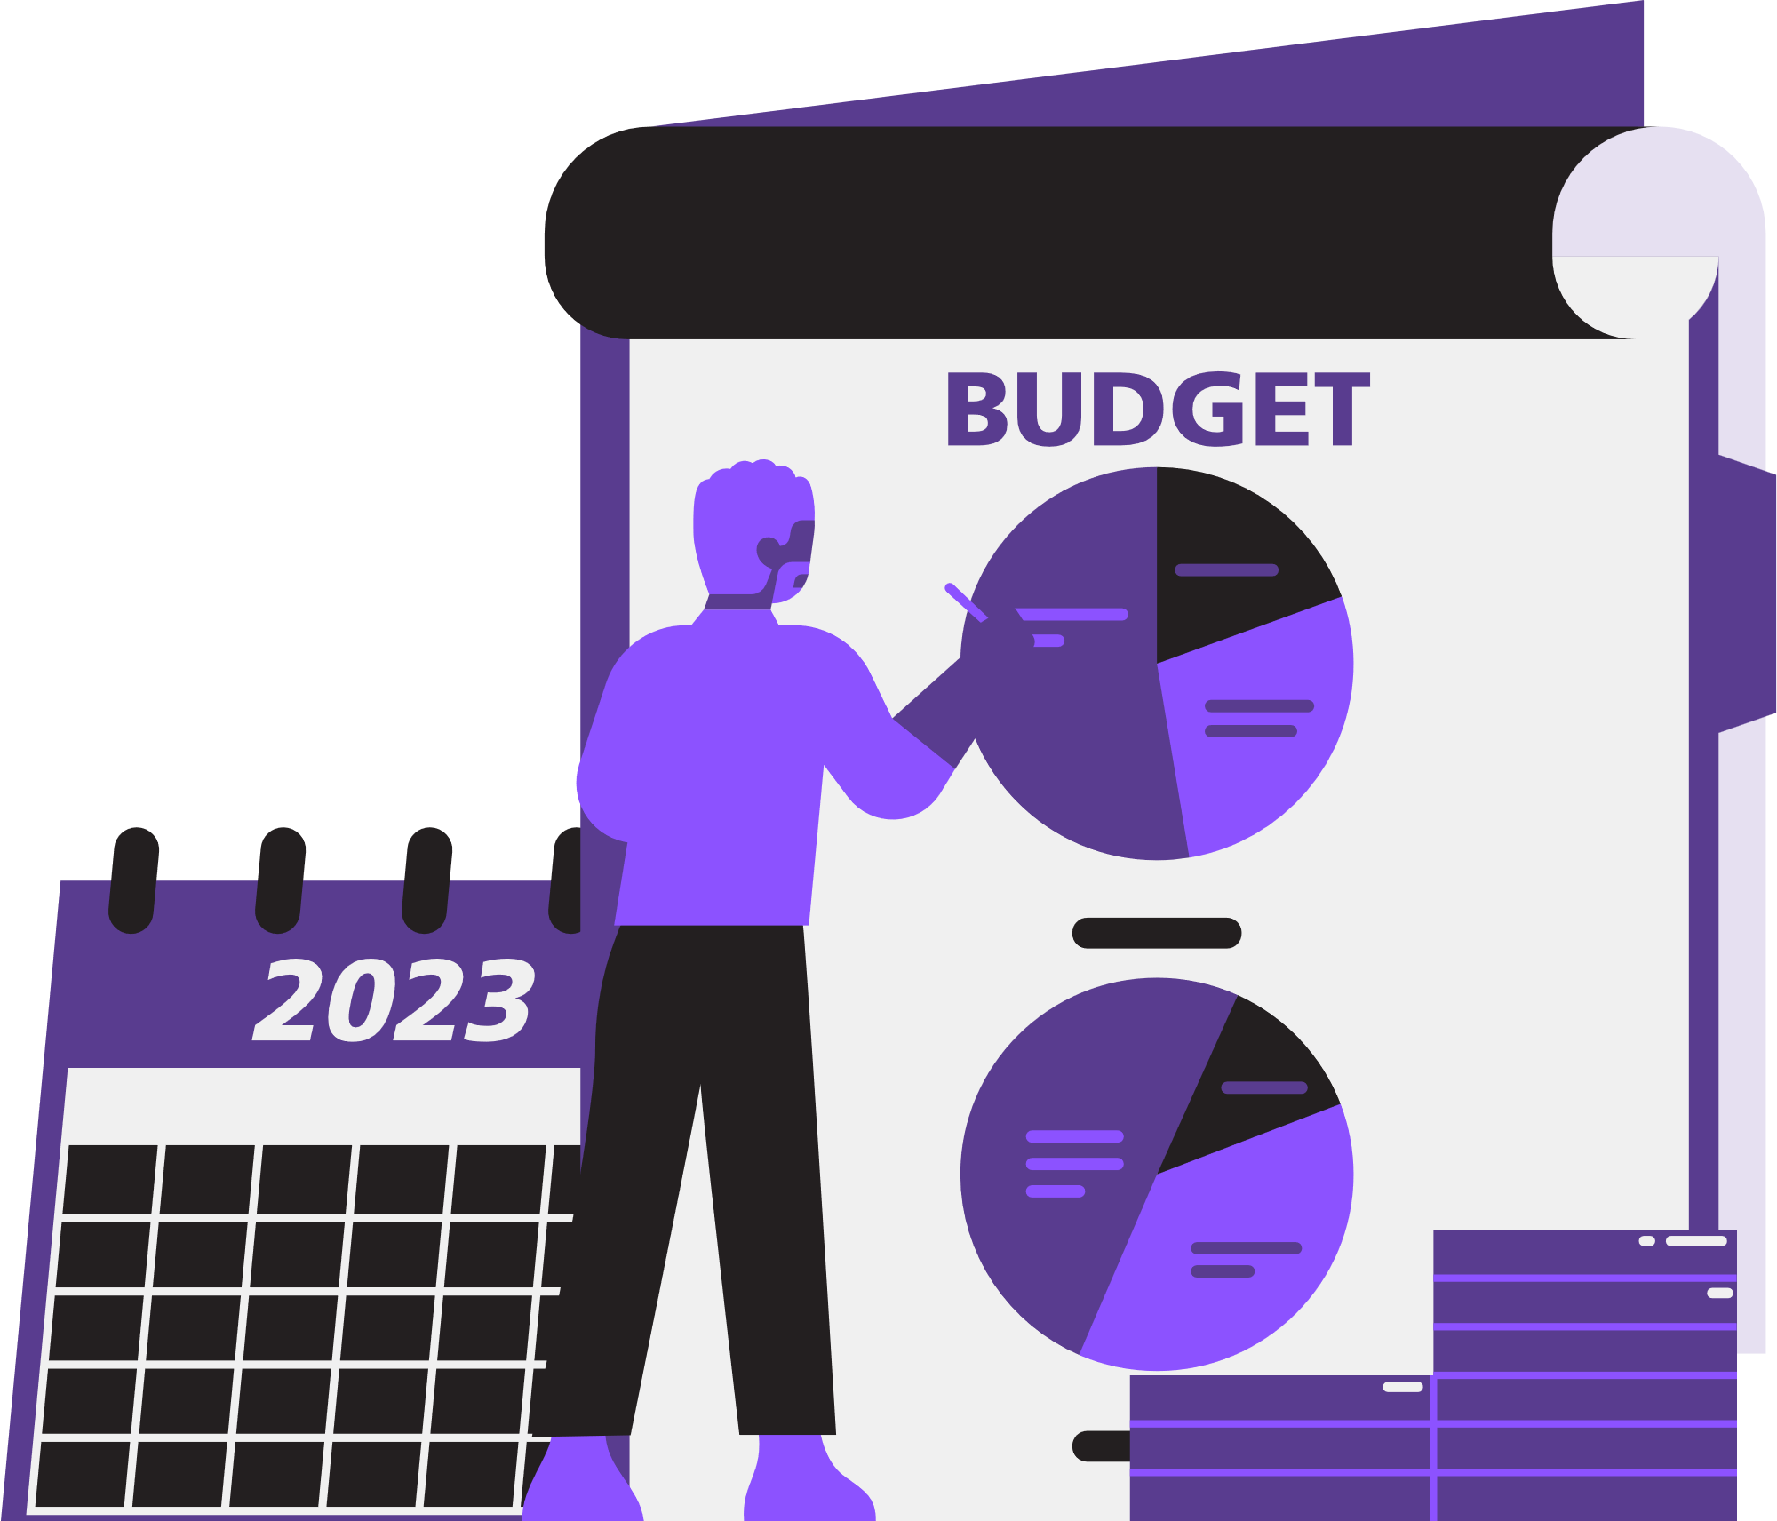
Project Overview
Statement
Goals
Develop a user-friendly system to track personal finances, manage expenses, and generate financial reports.
A user-friendly interface for expense tracking, comprehensive reporting, and data analysis, complemented by budget management alerts to monitor and control spending effectively.

Slide 3
Technology Stack
HTML, CSS: Frontend
Django Framework
MySQL: Database
Chart.js: Data Visualization

Slide 4
How It Works
Step 1: Register or log in to access your dashboard.
Step 2: Input income and expenses securely.
Step 3: Categorize transactions for better organization.
Step 4: Set budgets and financial goals to stay on track.
Step 5: The Data will be visualized for better Understanding

Slide 5
Functionalities
Easy to Understand: Presents financial transaction history in a clear, simplified format with dynamically updated expenses.
Monthly Overview: Displays a pie chart illustrating the comparison between "Used Budget - Salary" and "Remaining Budget - Expenses."
Expense Categories: Visualizes spending across categories such as Rent, Bills, and more using a bar chart.
Hover Tooltip: Displays the exact amount in rupees when hovering over specific segments of the chart.

Slide 6
Module Overview
User Authentication
Expense Management
Securely manage user registration, login, and logout.
Add, update, delete expenses, and organize them by category.
Financial Reporting
Generate reports with detailed insights and visual representations.
Dashboard & Visualization
Budget Planning & Alerts
Display key financial metrics and interactive charts for spending analysis.
Set budget limits, receive alerts when approaching or exceeding budgets.

Slide 7
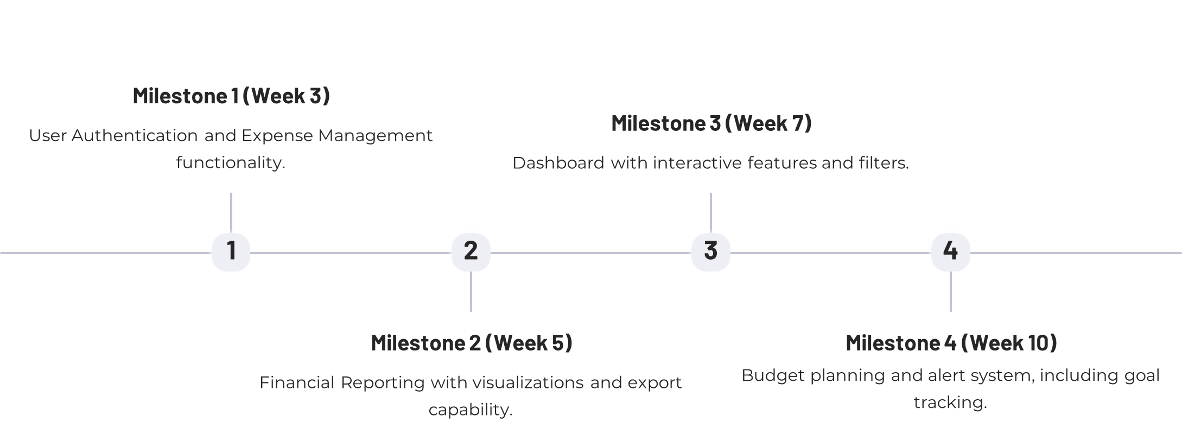
Milestones

Slide 8
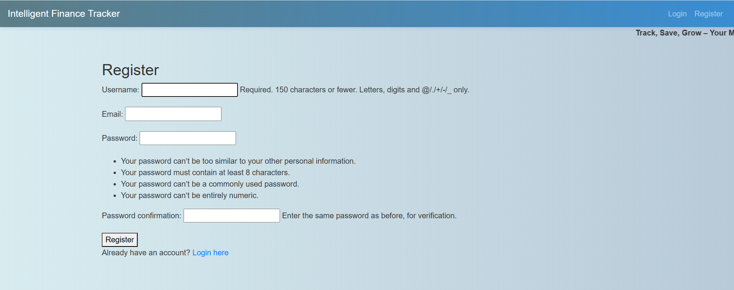
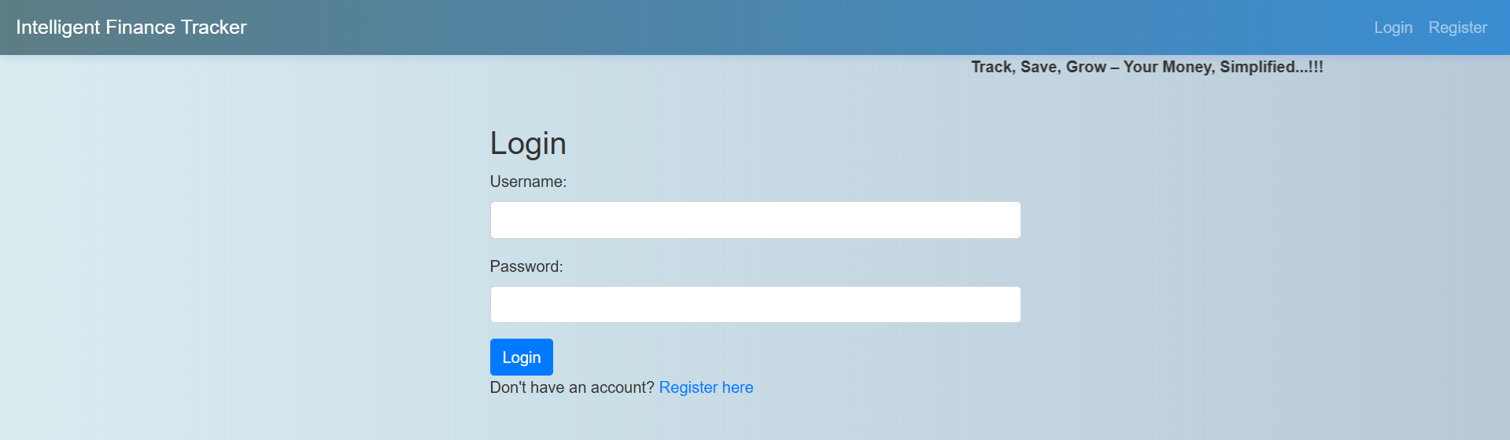
Milestone 1: Weeks 1-3
Module 1: User Authentication
User registration functionality.
Secure login and logout mechanisms.
User dashboard displayed post-login.
Form validations for all authentication
Implement password recovery and reset functionality to ensure seamless account access for users

Slide 9
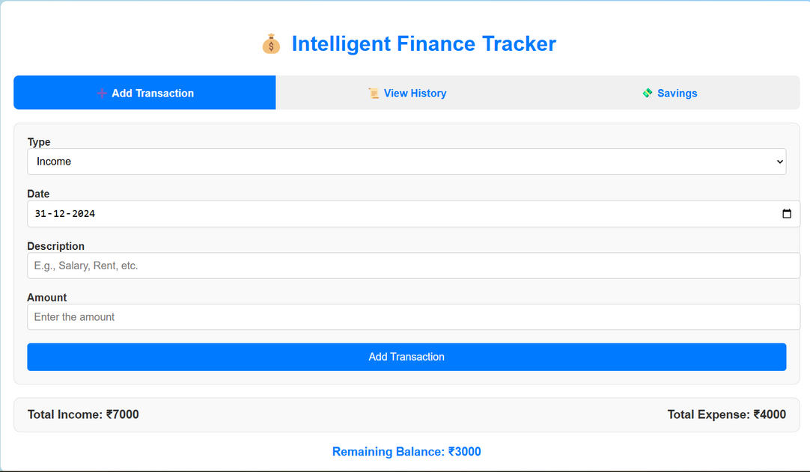
Milestone 1: Weeks 1-3
Module 2: Expense Management
Develop database design, add, update, delete expense functionality, and list all expenses.

Slide 10
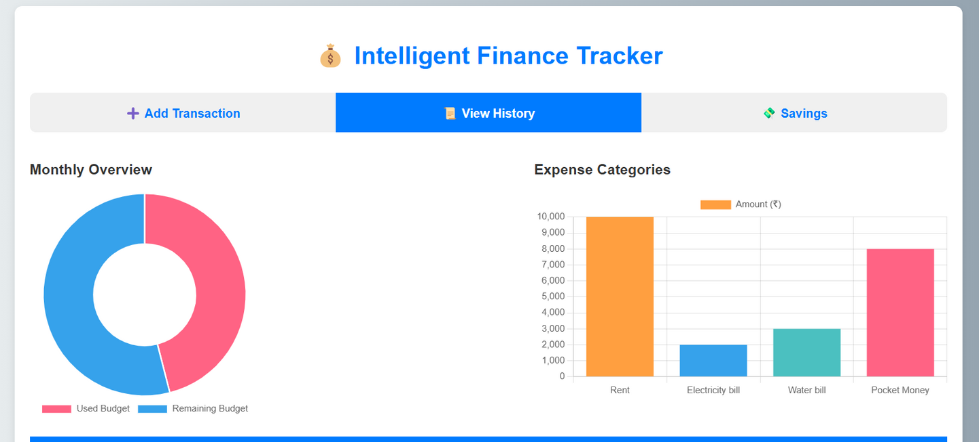
Milestone 2: Weeks 4-5
Module 3: Financial Reporting
Design interface for financial reports, enable date range selection, create visualizations, and export reports as PDFs.

Slide 11
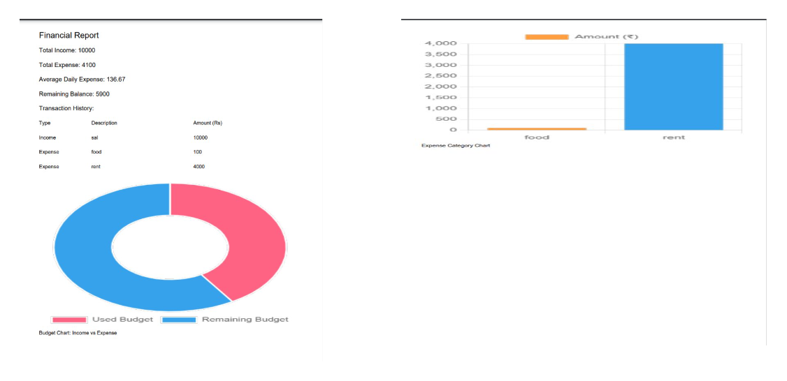
Milestone 2: Weeks 4-5
Module 3: Financial Reporting
Design interface for financial reports, enable date range selection, create visualizations, and export reports as PDFs.

Slide 12
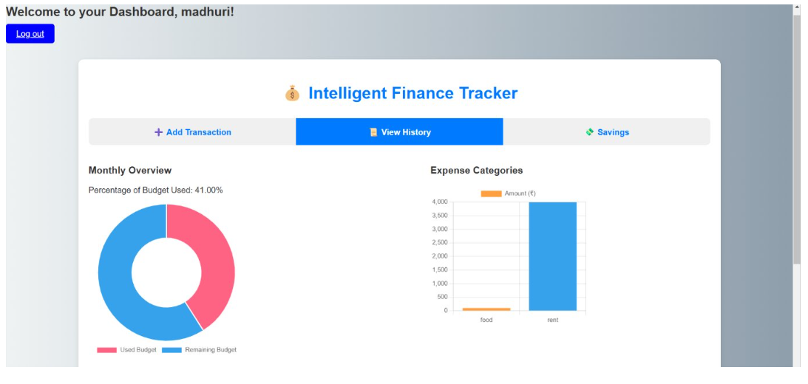
Milestone 3: Weeks 6-7
Module 4: Dashboard & Data Visualization
Develop key financial metrics, interactive charts, filters, budget tracking, and responsive design.

Slide 13
Register page​

Slide 14
Login page​

Slide 15
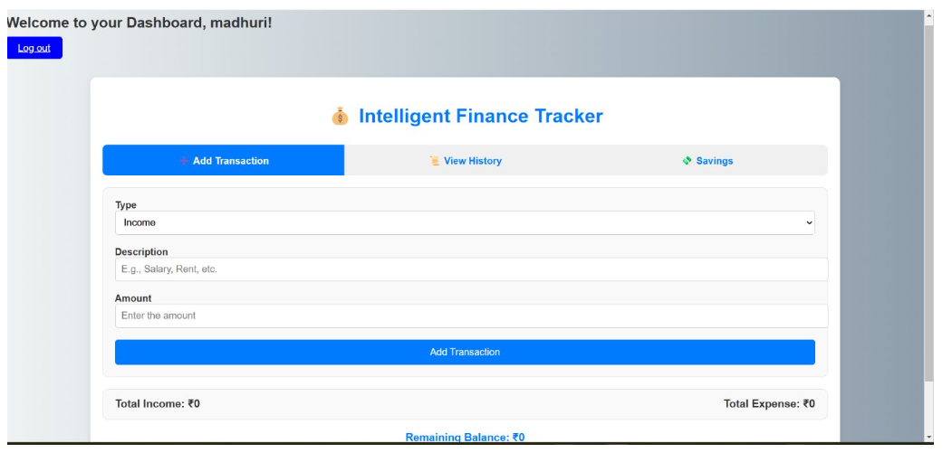
Add Transaction page​

Slide 16
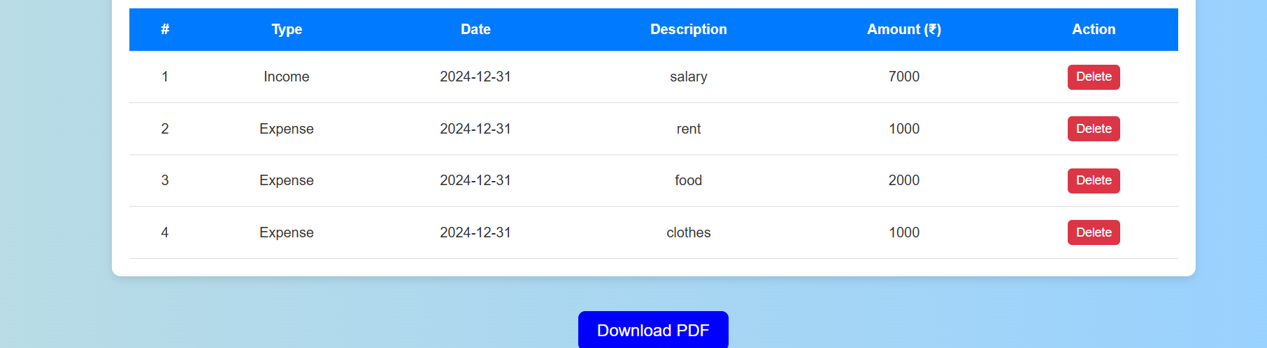
View Transaction Page​

Slide 17
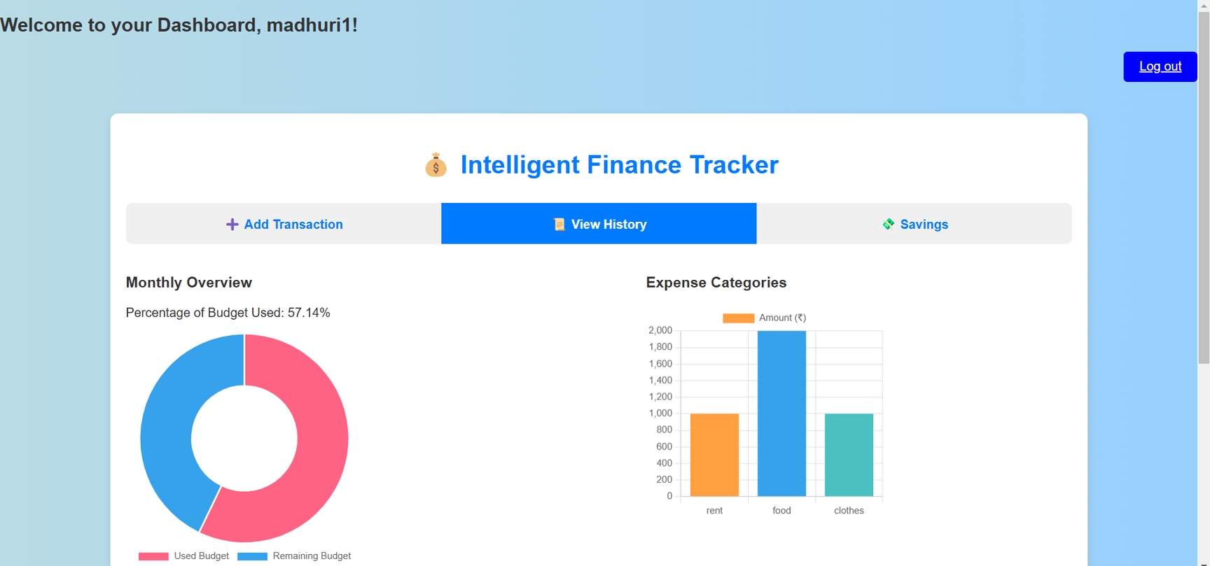
Data Visualization Page​

Slide 18
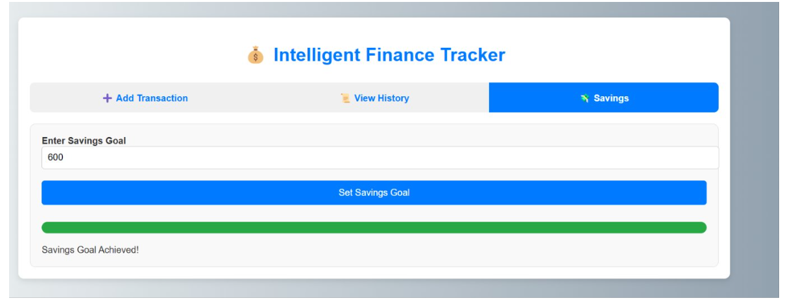
Saving Goals Page​

Slide 19
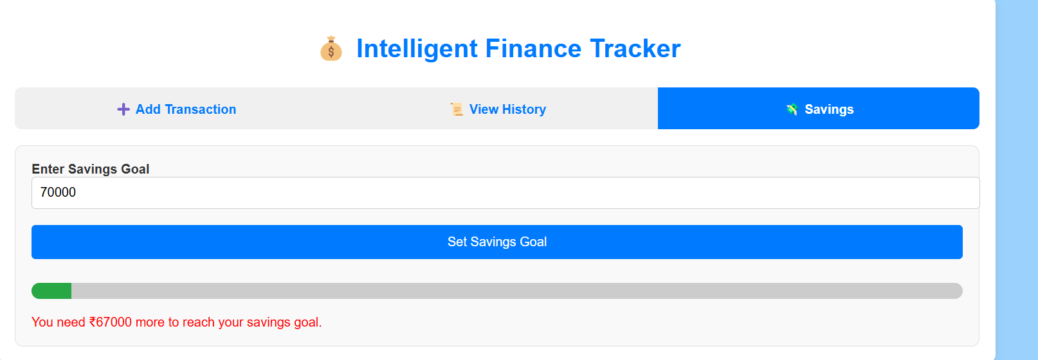
Saving Goals Page​

Slide 20
Download Pdf feature​

Slide 21
THANK YOU

